Slide 1
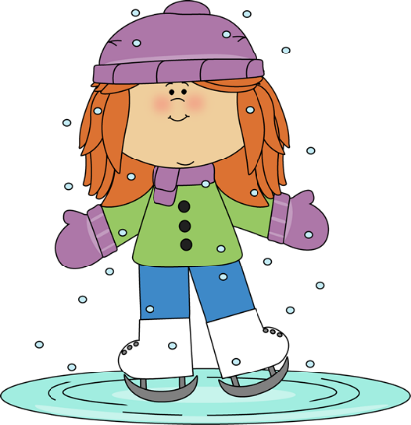
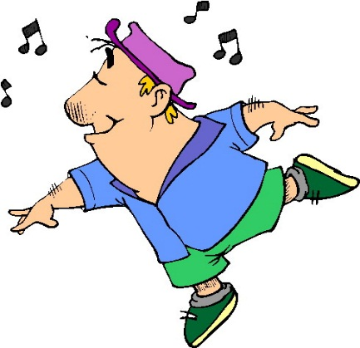

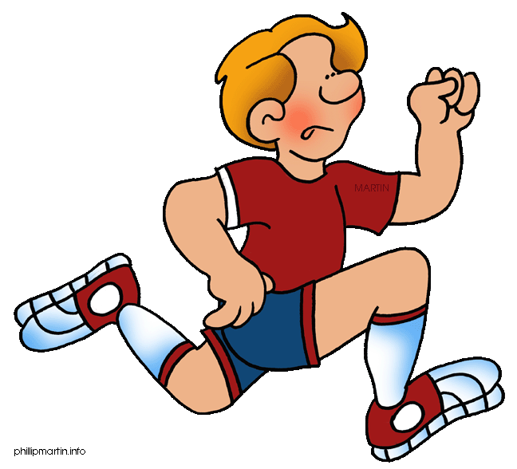
1. Hobby
취미(chwimi)

Slide 2
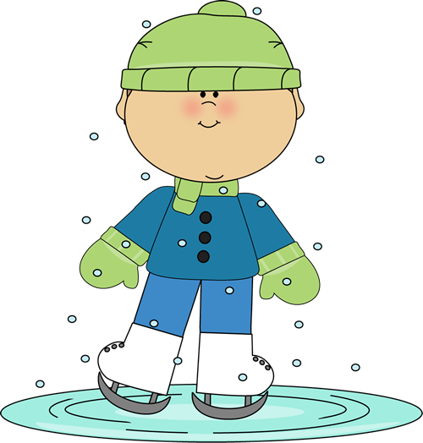
His
He
His
His hobby is ice skating.

Slide 3
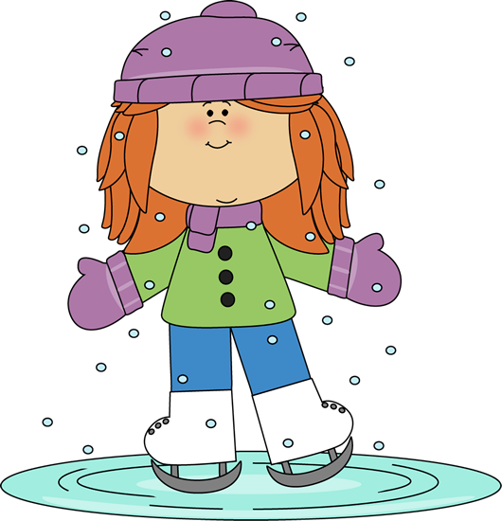
Her
She
Her hobby is ice skating.
Her

Slide 4
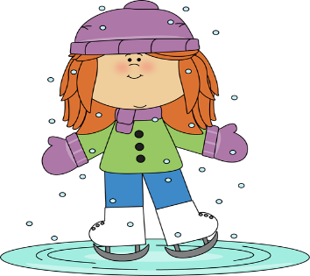
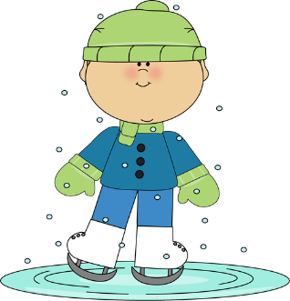
Their
they (he and she)
they (he and he)
they
Their
Their hobby is ice skating.

Slide 5
What is his hobby?
is
His
hobby
He
ice skating
His hobby is ________.

Slide 6
What is her hobby?
is
Her
hobby
She
singing
His hobby is ________.

Slide 7

What is their hobby?
is
Their
hobby
Their
dancing
Their hobby is _______.

Slide 8


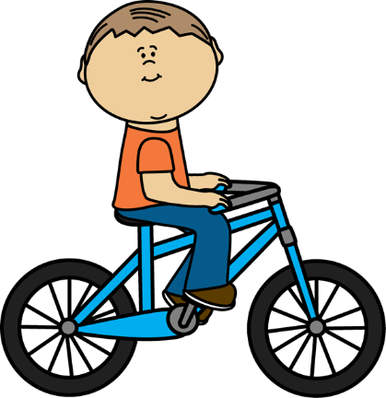
Hobbies 취미(chwimi)
singing
running
ice skating
dancing
Hello, my name is…
speaking English
riding a bike
playing the guitar
playing the piano

Slide 9
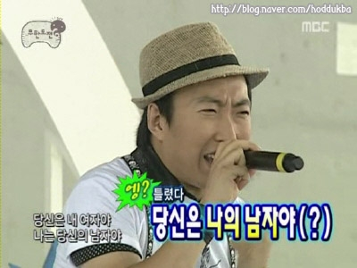
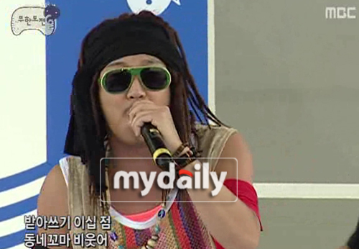
What is his hobby?
His hobby is singing.

Slide 10
What is her hobby?
Her hobby is playing the piano.

Slide 11
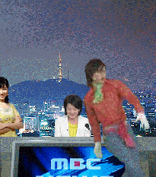





What is their hobby?
Their hobby is dancing.

Slide 12
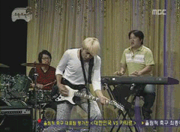
What is his hobby?
His hobby is playing the guitar.

Slide 13
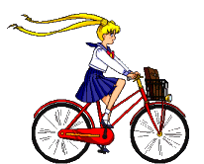
What is her hobby?
Her hobby is riding bicycles.

Slide 14
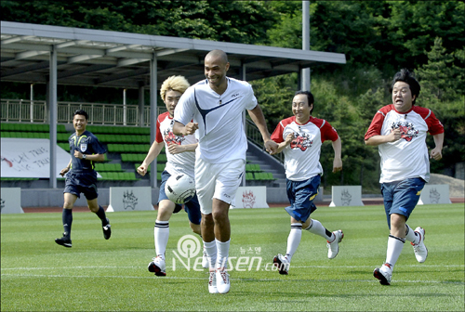
What is their hobby?
Their hobby is playing soccer.

Slide 15
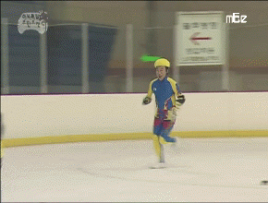
What is his hobby?
His hobby is running.

Slide 16
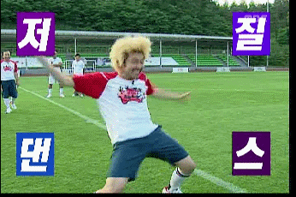
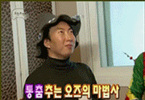

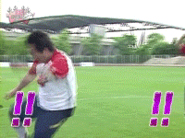
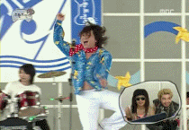



What is their hobby?
Their hobby is dancing.

Slide 17


What is her hobby?
Her hobby is speaking English.

Slide 18
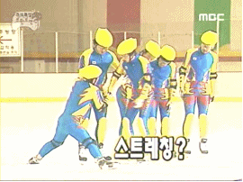
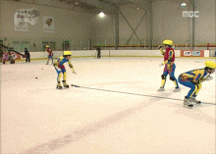
What is their hobby?
Their hobby is Ice-skating.

Slide 19
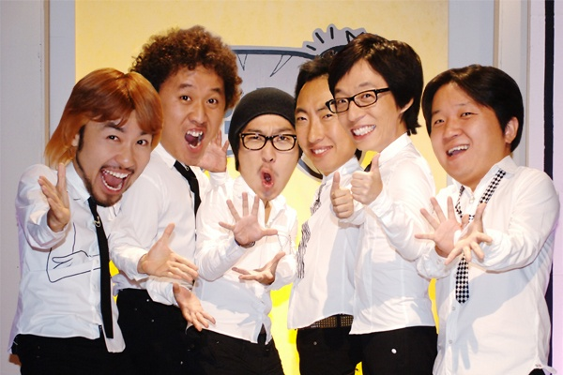
What is your hobby?
is
My
hobby
His hobby is ________.

Slide 20

Goodbye!

