Slide 1
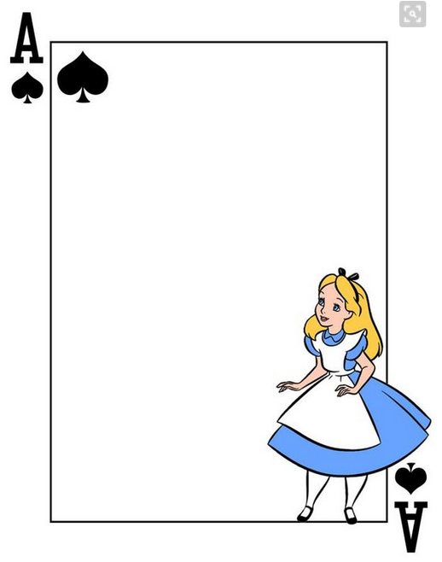
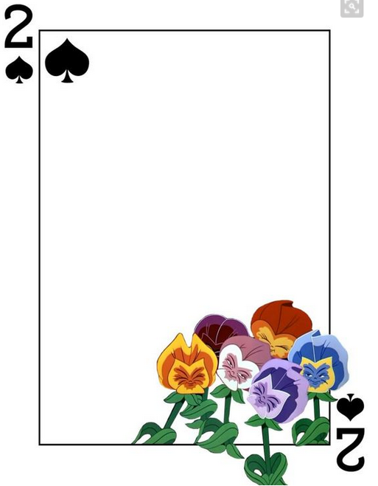
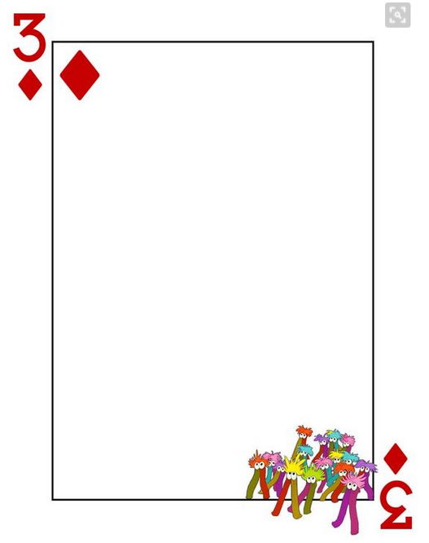
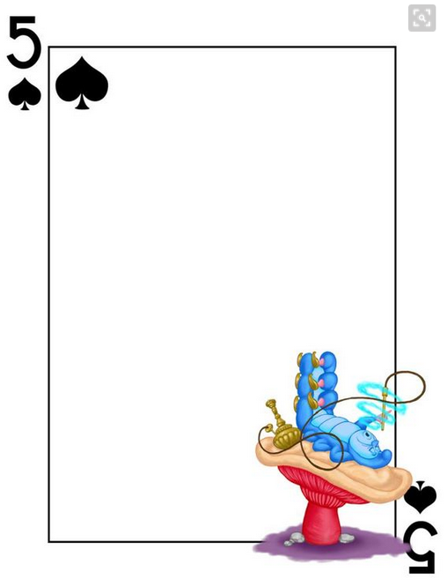
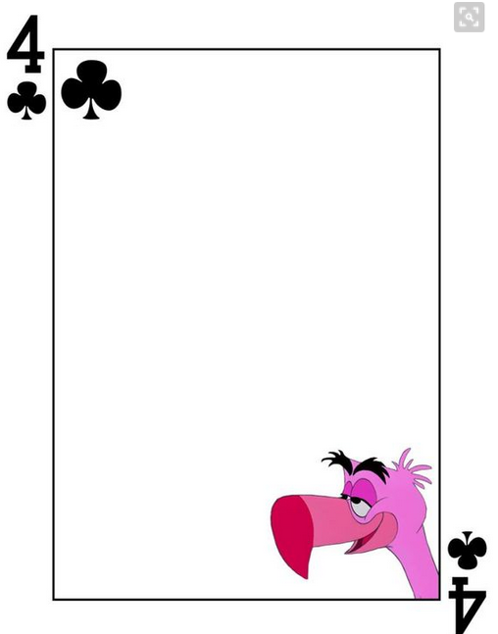
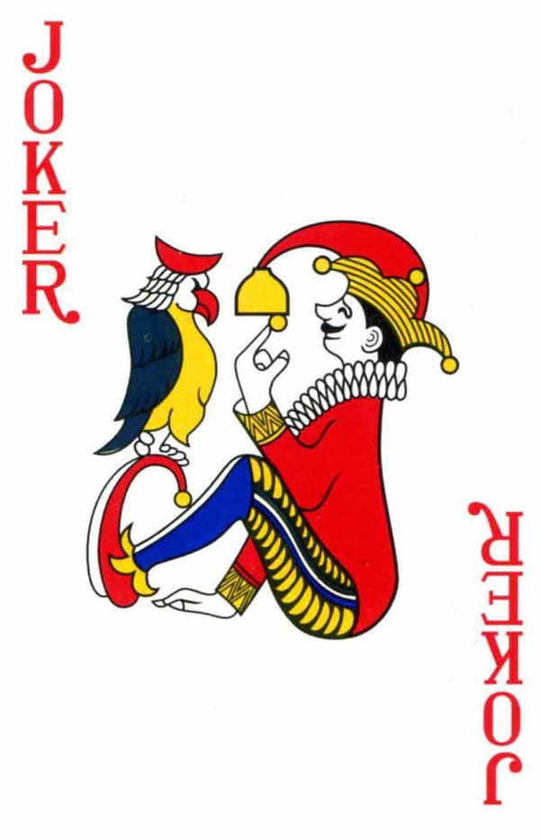
rough
soft
slimy
smooth
and
soft
rough
and
dry

Slide 2
sticky
smooth
wet
soft
and
rough
smooth
and
sticky

Slide 3
dry
smooth
wet
dry
and
rough
wet
and
sticky

Slide 4
Plush doll
Kitchen sponge
Sandpaper
Water
Sand
Tape
Toy slime
CD

